Slide 1

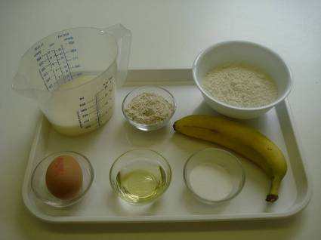
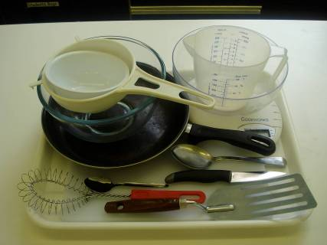
This recipe is from the original Licence to Cook programme and is provided under the Open Government Licence.
Sweet mini-pancakes
Ingredients
100g self-raising flour
25g wholemeal self-raising flour
1x15ml spoon caster sugar
180ml milk
1 egg (medium)
100g fruit, e.g. blueberries, raspberries, banana, sultanas
oil for frying
Equipment
Chopping board
Knife
Weighing scales
Sieve
Mixing bowl
Whisk
Measuring jug
Frying pan
15ml spoon
Fish slice
© Food – a fact of life 2019
www.foodafactoflife.org.uk

Slide 2
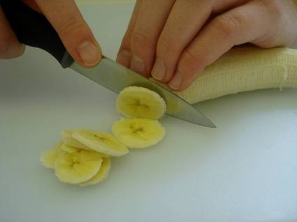
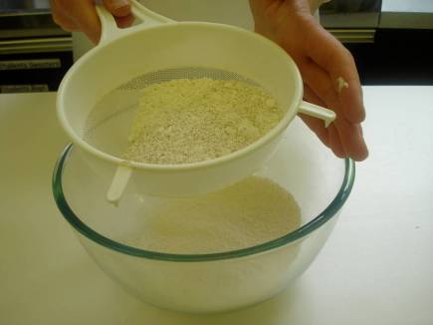
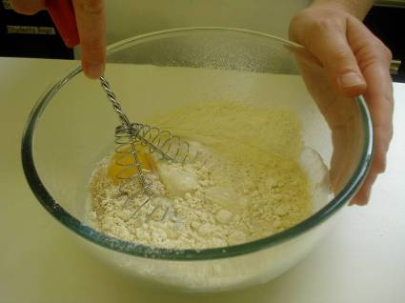
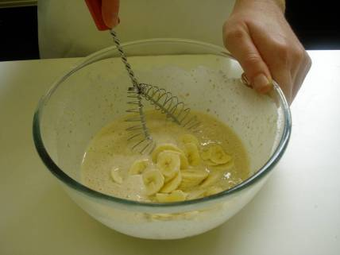
This recipe is from the original Licence to Cook programme and is provided under the Open Government Licence.
Method
Chop the fruit into small chunks, or keep whole (depending on size of fruit)
Sift the flours into the bowl and add the sugar.
Whisk the egg and milk into the flour.
Stir in the fruit.
© Food – a fact of life 2019
www.foodafactoflife.org.uk

Slide 3
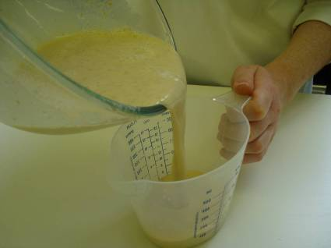
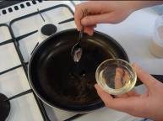
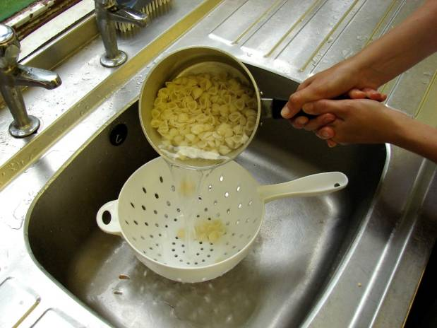
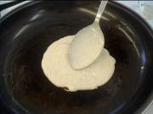
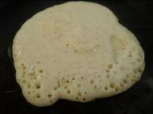
This recipe is from the original Licence to Cook programme and is provided under the Open Government Licence.
Method
Pour into the measuring jug.
Heat the frying pan and add a few drops of oil.
Slice the pepper into small strips.
Pour in 2 x 15ml spoons of mixture for each pancake.
Cook until bubbles appear on the surface and then turn, using the fish slice.
© Food – a fact of life 2019
www.foodafactoflife.org.uk

Slide 4
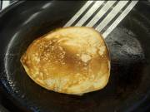
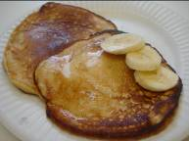
This recipe is from the original Licence to Cook programme and is provided under the Open Government Licence.
Method
Cook the underside of the pancake for one minute, or until golden brown.
Slice the pepper into small strips.
Serve.
© Food – a fact of life 2019
www.foodafactoflife.org.uk

