Slide 1
Sweet mini-pancakes
Complexity: low-medium

Slide 2
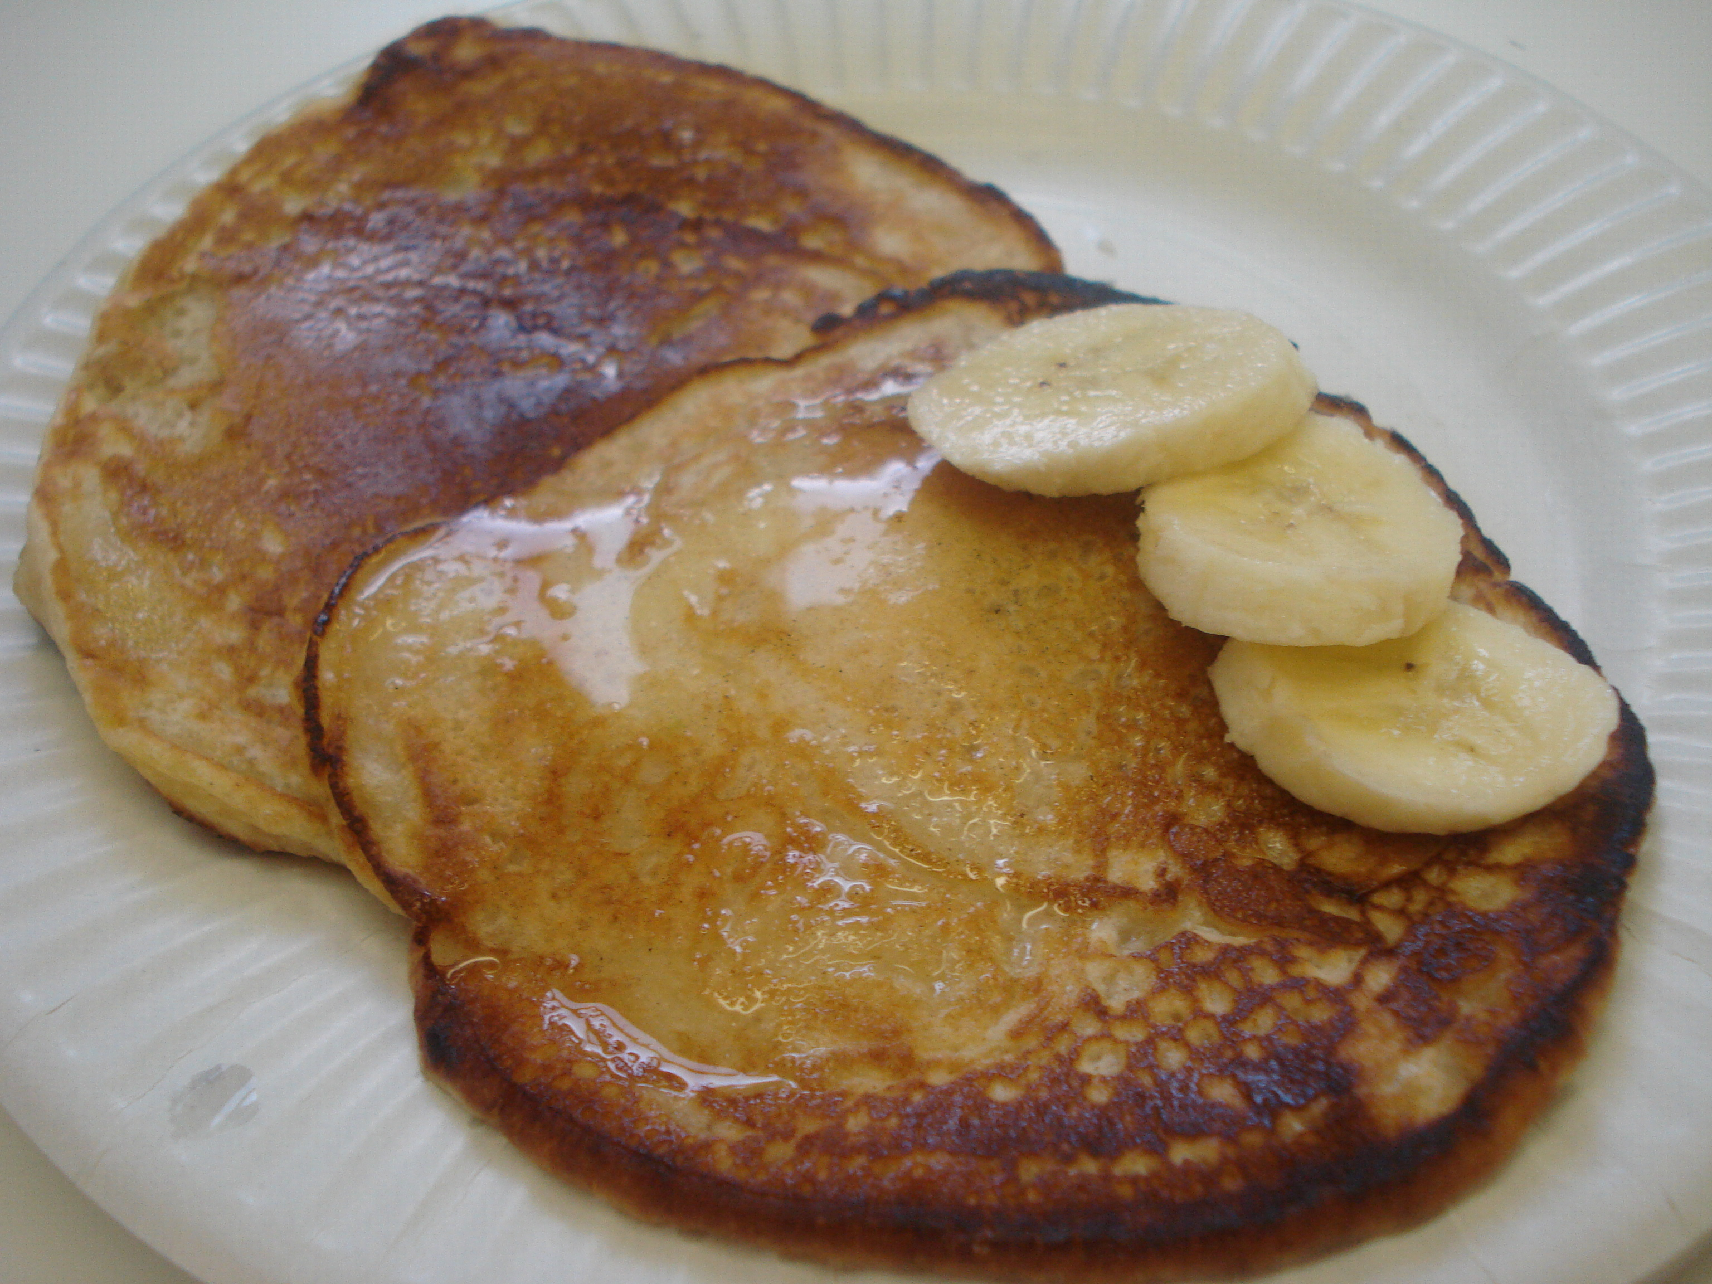

Slide 3
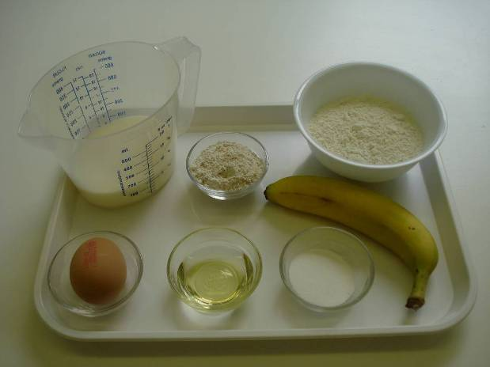
Ingredients
100g self-raising white flour
25g self-raising wholemeal flour
1 x 15ml spoon caster sugar
180ml milk
1 egg (medium)
100g fruit, e.g. banana
Oil for frying

Slide 4
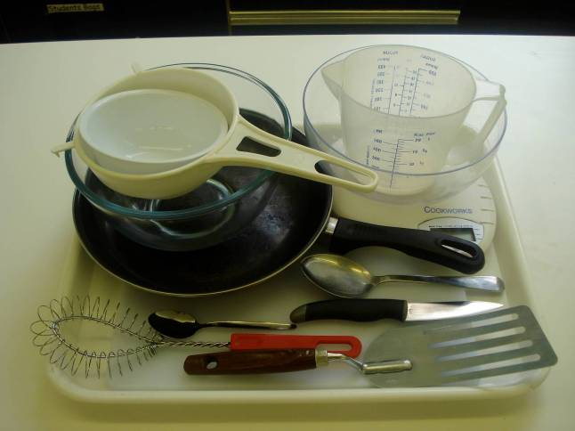
Equipment
Chopping board
Knife
Weighing scales
Sieve
Mixing bowl
Whisk
Measuring jug
Frying pan
Wooden spoon
Frying pan
15ml spoon
Fish slice

Slide 5
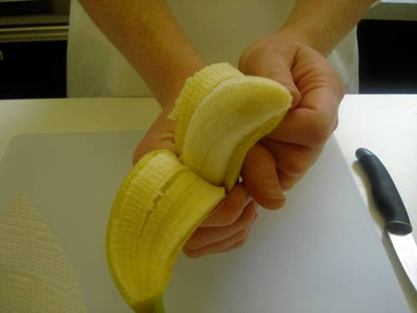
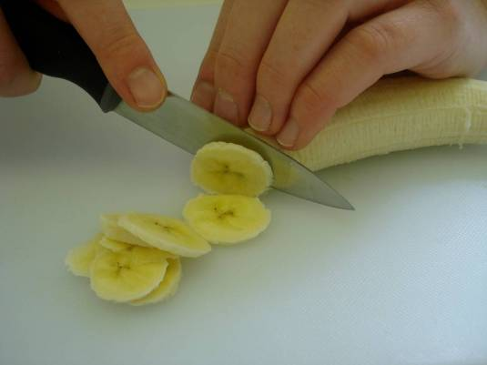
Method
Chop the fruit into small chunks or keep whole (depending on the size of fruit.

Slide 6
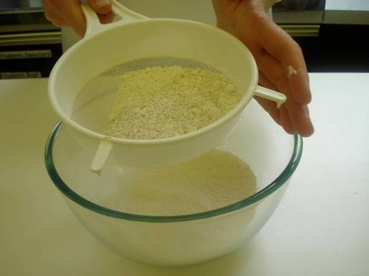
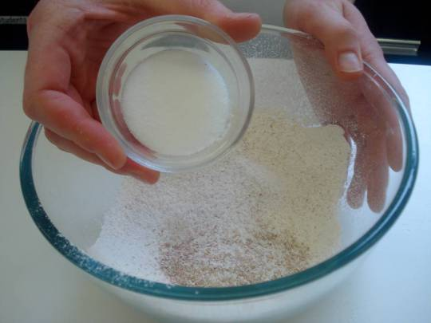
Sift the flours into a mixing bowl and add sugar.

Slide 7
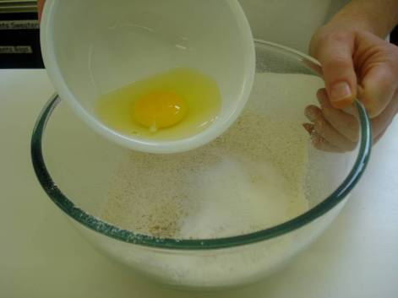
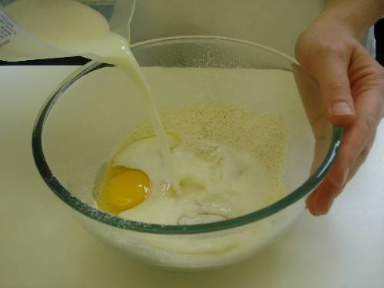
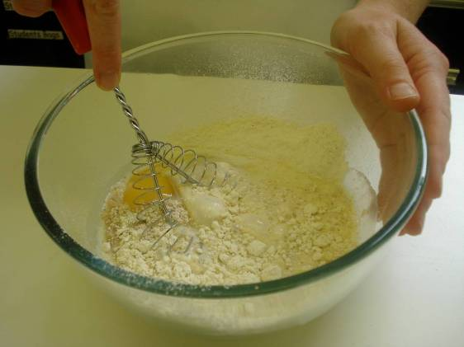
Whisk the egg and milk into the flour.

Slide 8
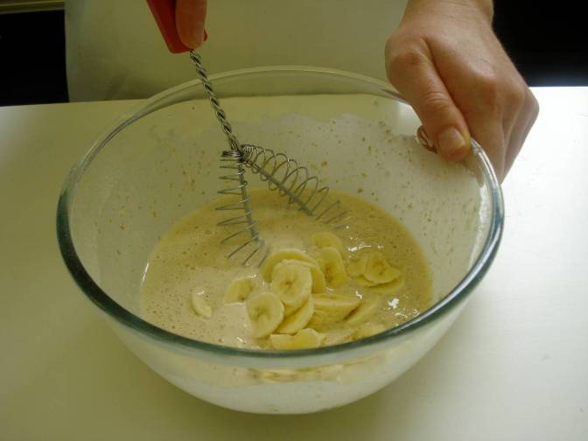
Stir in the fruit.

Slide 9
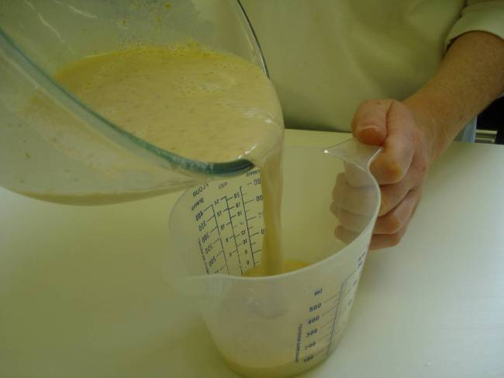
Pour into the measuring jug.

Slide 10
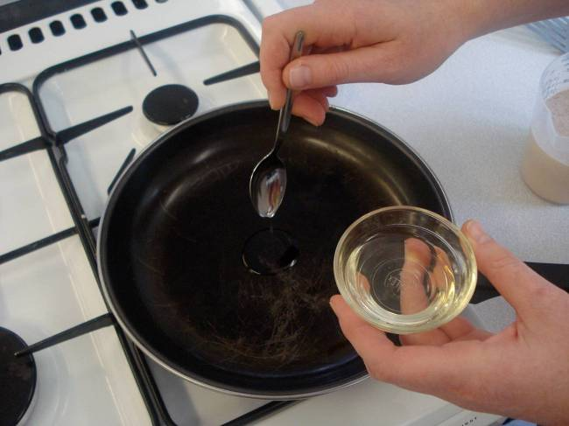
Heat the frying pan and add a few drops of oil.

Slide 11
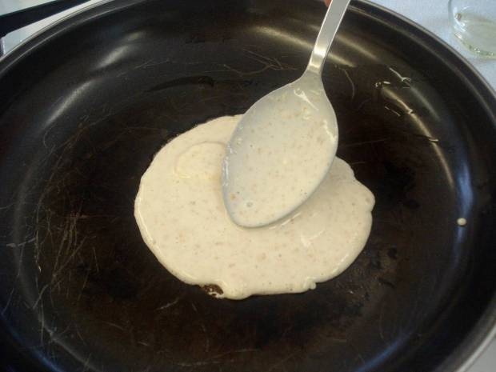
Pour in 2 x 15ml spoons of mixture for each pancake.

Slide 12
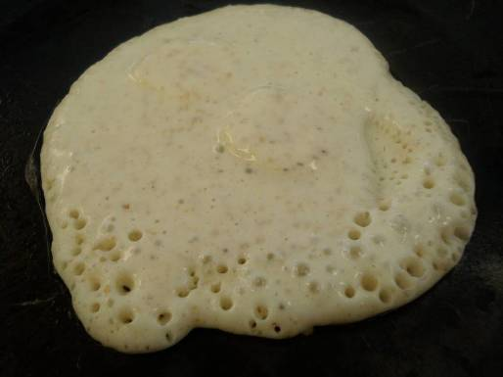
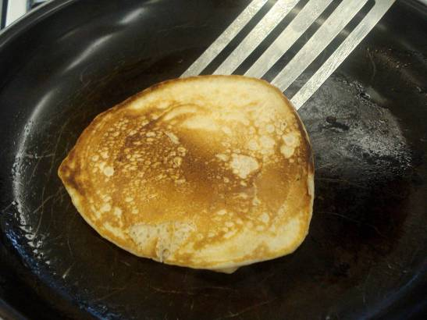
Cook until bubbles appear on the surface and then turn over using the fish slice.

Slide 13
Serve.

Slide 14
Top tips
Food skills
Use canned fruit pieces, so that you don’t have to chop anything.
Transfer the pancake batter to a jug or use a ladle to reduce the spills as the mixture is placed in the frying pan.
Serve with low fat Greek yogurt, and a drizzle of honey.
Weigh.
Measure.
Whisk.
Stir and combine.
Fry.
Cut (if using fresh fruit).

Slide 15
Sweet mini-pancakes
For further information, go to:
www.foodafactoflife.org.uk

